Slide 1
Data Driven VM Selection
Supraja Suresh
&
Vandana Kannan

Slide 2
Agenda
Introduction
Why VM selection?
Ernest
CherryPick
PARIS
Current options
Conclusion

Slide 3
Introduction
Organizations of all scales are moving towards the cloud
Different Organizations have different uses cases and needs
Users from the same organization have varying needs
One single VM type will not be suitable to cater to the needs of all the organizations and the users within them

Slide 4
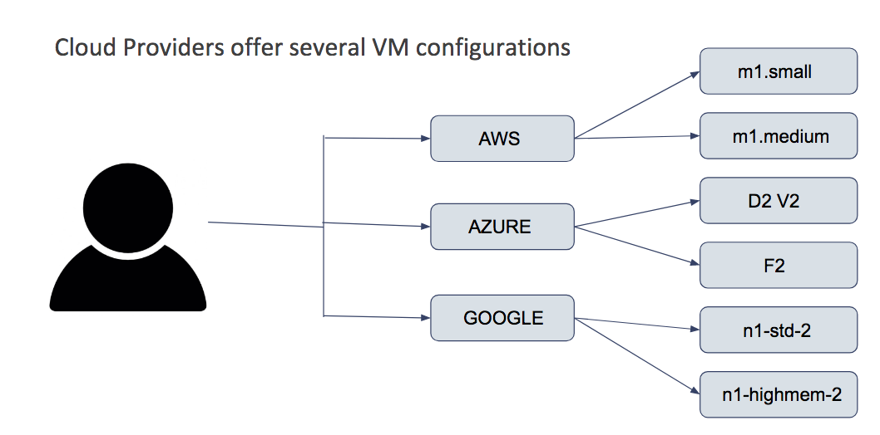
Introduction

Slide 5
Why VM selection?
Different users have different goals
User1 might want to minimize the cost by choosing the cheapest VM type
User2 might want to gain high performance without cost constraints choosing the high end VM available
User3 might want to choose a middle ground with considerate performance and mediocre cost
Choosing the right VM to meet the user goals is critical

Slide 6
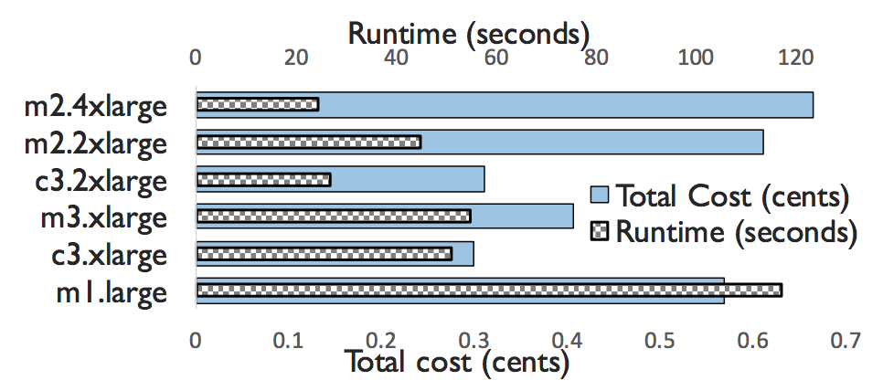
Why VM selection?

Slide 7
Why VM selection?
Problems with the choices made by the users
User1 will end up with higher cost and low performance as the capacity of the VM is low
User2 over provisions and ends up with higher cost with marginally better improvements than much cheaper alternatives
User3 is being wise and trying to make a tradeoff between cost and performance
How will User3 know which instance type will achieve his goal?

Slide 8
Why VM selection?
How will User3 know which instance type will achieve his goal?
Randomly/Intuitively pick one
Assign the most expensive/cheapest VM type
Use Machine Learning and let it help narrow down the search or provide the optimal configuration

Slide 9
Why VM selection?
Machine Learning based approach addresses the following issues:
Bigger is not always better
Similar configurations provide different performance
Optimizing for mean performance is not always desired
Resource Requirement for a workload is not known initially

Slide 10
How can ML help here?
In general,
Given some training data
Need to predict for test data
Using a model
What does this mean in the context of VMs?

Slide 11
Ernest
Current popular workloads:
Machine learning,
Natural language processing,
Deep learning
Genome analysis
Particle accelerator data processing
Challenges of modeling for complex applications
Varied data sets
No relevant history
Different from traditional workloads
Ref: S. Venkataraman, Z. Yang, M. Franklin, B. Recht and I. Stoica, "Ernest: Efficient Performance Prediction for Large-Scale Advanced Analytics," in 13th USENIX Symposium on Networked Systems Design and Implementation (NSDI 16), Santa Clara, 2016.
Notes:
Speaking of Machine Learning, ML, deep learning, NLP are a few popular workloads deployed on the cloud today.
These differ from traditional analytics workloads (e.g., SQL queries)
data-intensive
computation-intensive,
and typically run for a long time.
Selecting RAM, storage medium, number of instances becomes more important.
Lets consider a ML workload.
Usually, for ML, we look at history to collect data. But, varied data sets are used, its hard to come up with a pattern.
Then there are a lot of parameters that can be tweaked, so its difficult to pick and predict
Even though techniques have been proposed for MapReduce, it may not be applicable for Spark.

Slide 12
Ernest
Choose a VM for such workloads
User’s goals:
Minimize running time given a budget
Meet a deadline minimizing cost
Ernest = performance prediction model
Predict running time, given a job and input.
Notes:
This paper aims to choose a VM for such workloads.
Typical user’s goals are :
They have a budget, we need to minimize how long a workload runs to fit within the budget
The have a deadline to meet, but they need to minimize cost.
Ernest creates a performance prediction model
That given a job and an input, it will predict the running time on a VM

Slide 13
Ernest
Input
Main idea
Take instances of the job
Take samples of input
Execute on all possible VM configurations
Use the data to create a model
Why does this work?
Running time depends on input size
J1
J2
Jn
VM1
VM2
VM n

Slide 14
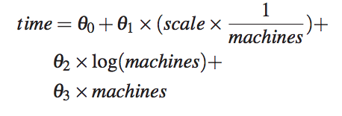
Ernest
Ernest considers 2 main features
Fraction of data used (scale)
Number of machine used
Creating the model
What data points to collect?
What features to derive?
Select relevant features
Notes:
Theta0 – serial computation
Theta1 – parallel computation
Theta2 – communication
Theta3 – overhead

Slide 15
Ernest
How do you select data points?
Use optimal experiment design
Given the max scale and number of machines, choose feature vectors such that estimation error is minimized.
Can Ernest fit all?
Model validation using cross validation (leave one out)
Model extension (Example: classification in MLLib for sparse datasets)
Notes:
Expt design – study of how to collect data for an experiment.
Optimal expt design – collecting data given certain constraints
In the context of ernest, the constraints are scale and the number of machine and even the cost.
The task is to choose feature vectors that would minimize the estimation error.
Ernest may not work well with randomized linear algebra.
How do you detect that Ernest will not work? Use cross validation – if there are m data points, train using m-1, then test on 1.
Suppose Ernest works well but misses few cases - can extend – there’s a classification implementation in MLLib

Slide 16
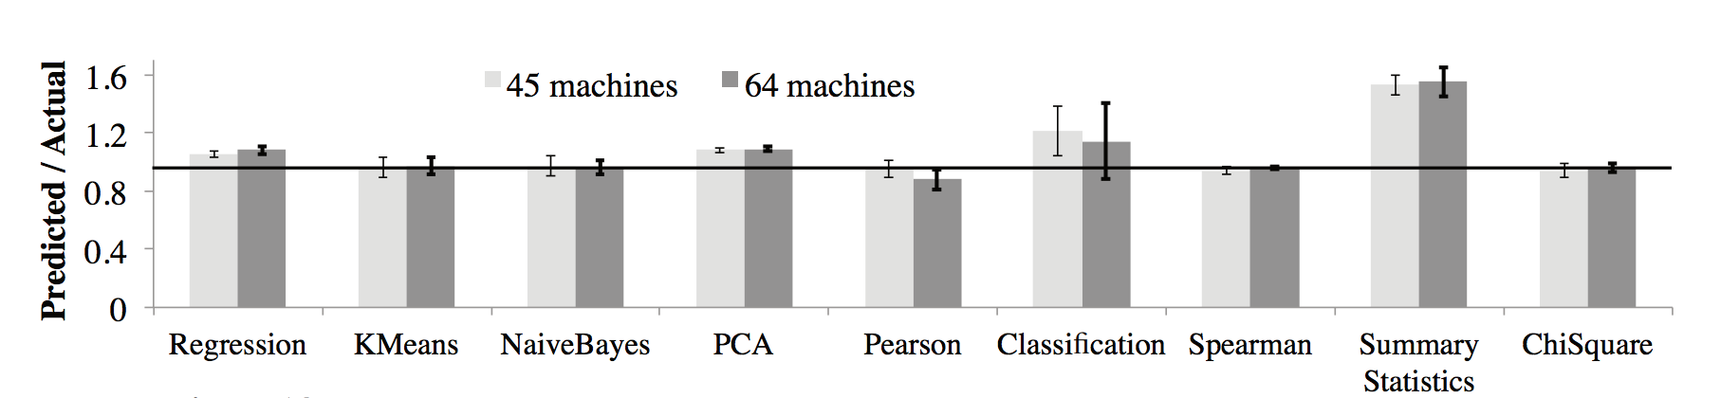
Ernest - Experiments
Evaluate based on 2 metrics:
Prediction accuracy
Overhead of training for long-running jobs
Example workload:
10K features for classification/clustering
1K features for statistical
Notes:
Accuracy – how close is Ernest’s predicted running time to the actual running time.

Slide 17
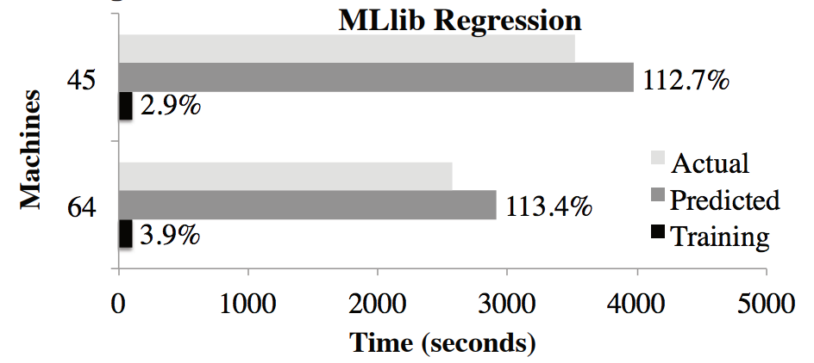
Ernest- Experiments
Training time for long-running tasks
500 iterations
Notes:
The authors performed experiments to show that training time is very small compared to the running time.
There are few more parameters such as how to decide how many VMs to select and which VM type to select

Slide 18
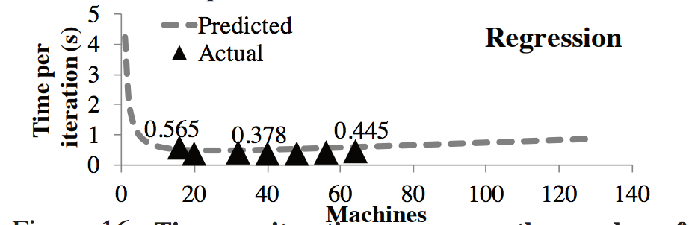
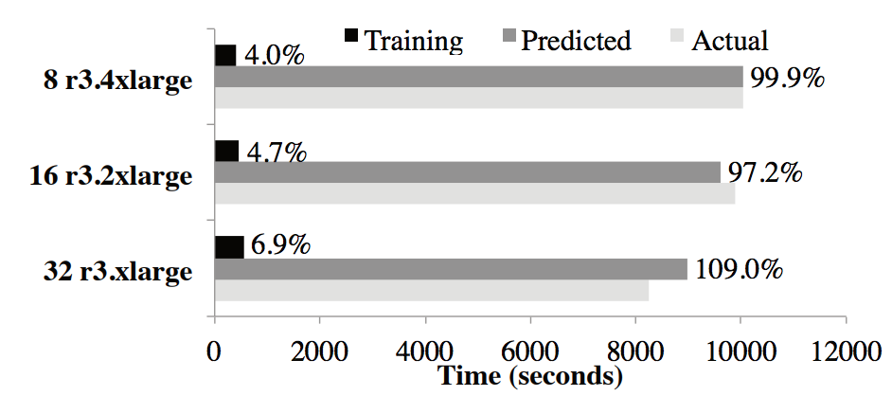
Ernest- Experiments
Notes:
There are few more parameters such as how to decide how many VMs to select and which VM type to select

Slide 19
Ernest - Summary
Advantages:
Accurate prediction
Small training time
Model suitability can be detected
Disadvantages:
Samples are executed on every VM type – O(n²)
Goals are fixed
Model parameters are fixed

Slide 20
CherryPick
Developed for Big data applications that run on a cluster containing several VM’s
Optimal configuration achieves high accuracy, low overhead, and adaptivity for different cases
Accuracy is hard to achieve - running time and cost depend on input workload, configuration and internal working.
Overhead for searching the best configuration must be low else it ll become expensive
O. Alipourfard, J. Che, H. L. Hongqiang, S. Venkatraman, M. Yu and M. Zhang, "CherryPick: Adaptively Unearthing the Best Cloud Configurations for Big Data Analytics," in In 14th USENIX Symposium on Networked Systems Design and Implementation (NSDI 17), Boston, 2017.
Notes:
Ernest prob –
Poor adaptivity – works for machine learning jobs and not say SQL queries
Can select VM sizes within a given instance family, retraining needed for each instance family

Slide 21
CherryPick
Aims at distinguishing near optimal solution from the other ones
Near optimal configurations minimizes usage cost, delivers good performance and reduces search overhead
Chooses few samples which minimizes the cost and running time
Uses Bayesian Optimization
More on that later ...
Notes:
Bayesian modelling - If we come up with a parametric family of functions, f(x; θ) and define a prior over θ, probability theory tells us how to make predictions given data.
prior - prior, of an uncertain quantity is the probability distribution that would express one's beliefs about this quantity before some evidence is taken into account. The unknown quantity may be a parameter of the model or a latent variable rather than an observable variable.
Bayes' theorem calculates the renormalized pointwise product of the prior and the likelihood function, to produce the posterior probability distribution, which is the conditional distribution of the uncertain quantity given the data.

Slide 22
CherryPick - Problem Formulation
Goal: Minimize the cost
T(~x) - running time function for an application and its input workloads where ~x is the cloud configuration vector that contains family types, CPU, RAM, …
P(~x) - price per unit time for all VMs in cloud configuration~x
C(~x) - total cost of cloud configuration ~x and
Tmax - maximum tolerated running time
The main aim = minimize C(~x) = P(~x)×T(~x) subject to T(~x) ≤ Tmax ---- (1)
BO used to minimize the cost by searching for approximate solution
(identifying actual solution is expensive )

Slide 23
CherryPick - Problem Formulation
Model C(~x) as a Gaussian Process, compute Confidence Interval using samples from C(~x)
BO decides the next point to sample using a pre-defined acquisition function
Acquisition function: Expected Improvement (EI) - picks the point which can maximize the improvement over the current best (out of scope if interested refer report)
BO is able to infer the confidence interval of C(~x) according to the samples of C(`x) and ε
C(`x) = C(~x) +ε ---- (2)
C(`x) is not normally distributed so apply log to both 1 and 2

Slide 24
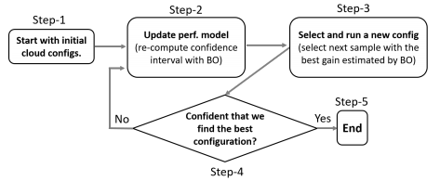
CherryPick - Model Design
Notes:
Stopping condition: when the expected improvement is less than a threshold and when at least N cloud configurations have been observed only then it is stopped.
Starting condition: fixed number of samples are taken from a quasi random sample to get uniform distribution.

Slide 25
CherryPick - Model Design
Starting condition: fixed number of samples are taken from a quasi random sample to get uniform distribution
Confidence Interval: the range that the actual value should fall in with high probability
Stopping condition: when the expected improvement is less than a threshold and when at least N cloud configurations have been observed only then it is stopped.
.

Slide 26
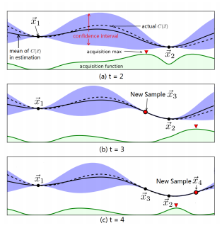
CherryPick - Sampling

Slide 27
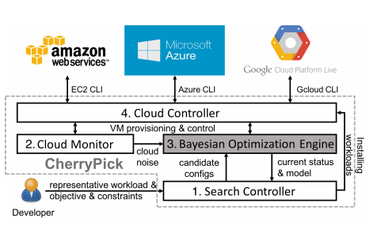
CherryPick - Implementation

Slide 28
CherryPick
Benchmarks used:
(1) TPC-DS (2) TPCH (3) TeraSort (4) The SparkReg (5) SparkKm
Advantage:
Finds optimal configuration with a high chance (45-90%) or a near-optimal configuration with low search cost and time
Disadvantage:
Tells which category of configuration works for a workload but not the actual configuration

Slide 29
PARIS
Why do we need another predictor?
Consider all possible performance metrics
Understand that user goals may change
Performance-cost trade-off
Exhaustive experiments take too long
PARIS = Performance Aware Resource Inference System
N. J. Yadwadkar, B. Hariharan, J. E. Gonzalez, B. Smith and R. H. Katz, "Selecting the Best VM across Multiple Public Clouds: A Data-Driven Performance Modeling Approach," in 7th ACM Symposium on Cloud Computing (SoCC ’17), Santa Clara, 2017.
Notes:
Now that we’ve seen 2 ways to predict performance and suggest VMs that can be used, why do we need another predictor?
There are some shortcomings or factors that have not been considered by previous works.
For example, only certain metrics such as running time has been considered, or it is assumed that users have just one goal – reduce cost, or
There has been no useful result which compares performance to cost, or the search for a suitable VM is so exhaustive that it takes too long.

Slide 30
PARIS
Motivation:
Mistakes that user’s make
Difference in hardware or software
User’s expectations are different
Not always aware about policies internal to the workload
Aim:
One-time data collection
Based on user’s inputs and goals
Experiment on real world workloads
Provide meaningful performance-cost trade-off
Notes:
As mentioned in the paper,
User may think that bigger is always better,
Hardware or software configurations need to be considered,
User may not always want to save on cost at the expense of performance
And you may not be aware of the internals of a workload.
So the aim of the paper is
To reduce data collection time
Allow the user to provide different workloads and goals
Perform experiments on real world workloads
And provide some actionable results

Slide 31
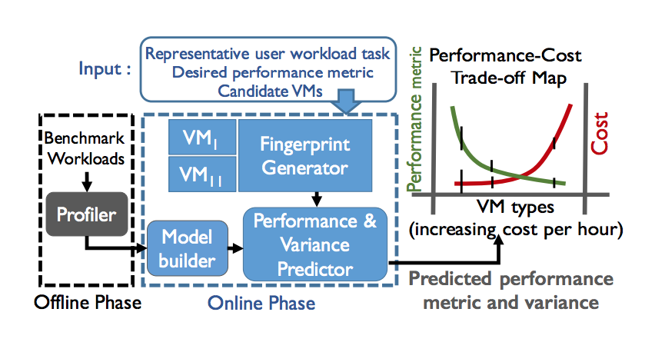
PARIS - Architecture
Offline phase:
One-time data collection
Online phase:
Predict based on training data

Slide 32
PARIS – Offline phase
Profiler: execute varied benchmarks on all VM types
Benchmarks:
Join and aggregation queries of Hive (OLAP queries)
YCSB core benchmark workloads (latency sensitive)
Squash compression service (multi-stage)
Each task is executed 10 times
Resource usage captured:
CPU utilization: - CPU idle time, user time, system time
Network utilization: - Bytes sent and received
Disk utilization: - Ratio of free to total disk space
Memory utilization: - Available virtual, physical, and shared memory
System-level features: Number of threads in different states
Notes:
YCSB - Yahoo! Cloud Serving Benchmark
Suite which tests a programs retrieval and maintenance capbilities. Used to test NoSQL

Slide 33
PARIS – Random Forest
g(fingerprint, target_vm) → (perf, p90)
Offline benchmarking dataset -> training dataset
Training dataset = fingerprint for each benchmark-VM combo
Fingerprint – resource utilization counters
Training time < 2 seconds

Slide 34
PARIS – Online phase
Input:
Sample task
Desired performance metric
Fingerprint generator:
Choose 2 reference VMs
Execute user task on them 10 times
Capture fingerprint
Test on Random Forest
Output:
Performance-cost trade-off map

Slide 35
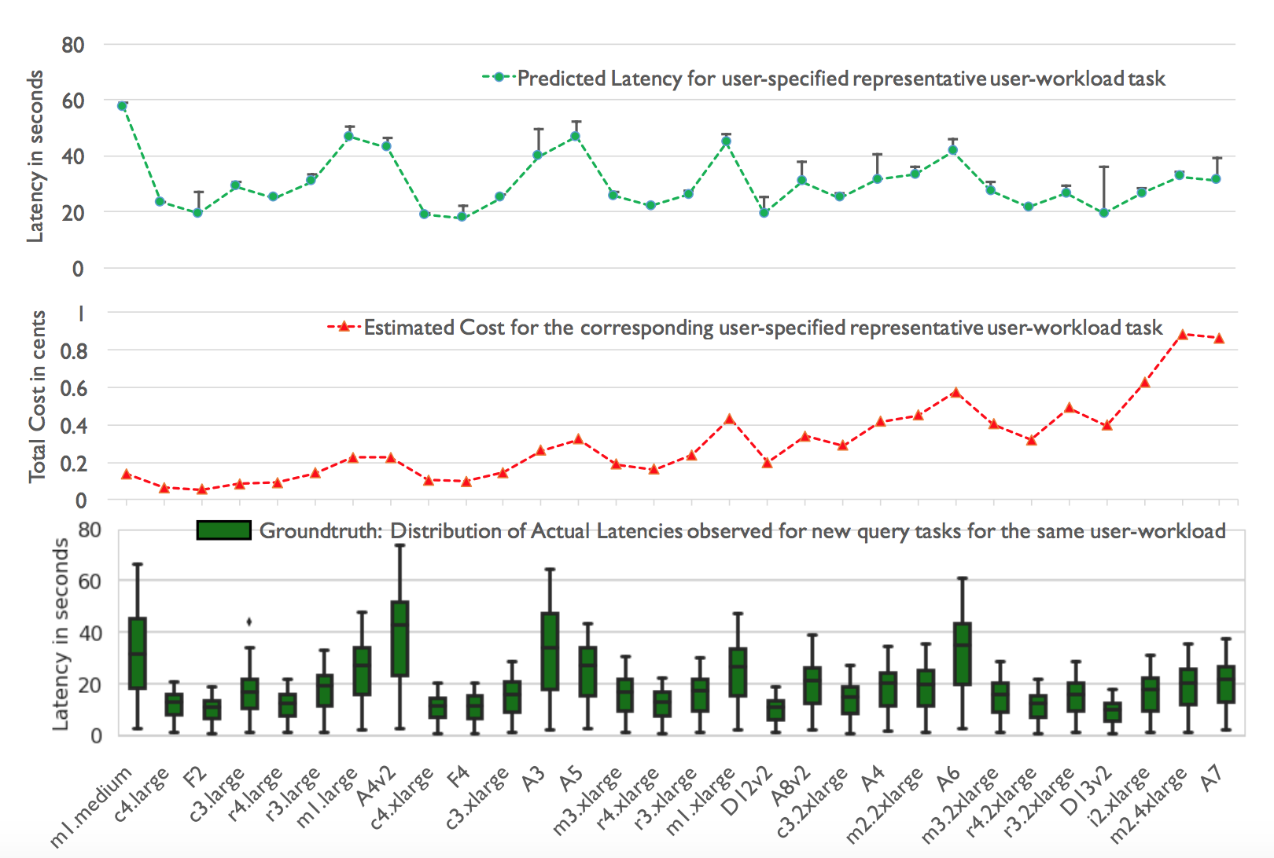
PARIS – Sample output
Task:
225K YCSB queries
On a
Redis data store

Slide 36
PARIS - Evaluation
Experiments were performed on Azure and AWS
Workloads:
Video encoding and compression
OLTP workloads
Metric evaluation: Mean Squared Error
How do we compare results?
Collaborative filtering
Baseline 1
Parameters for evaluation:
Prediction accuracy
Robustness
Usefulness
 | VM1 | VM2 | VM3 | VM4
BM1 | xxx | xxx | xxx | xxx
BM2 | xxx | xxx | xxx | xxx
Test |  | yyy | yyy

Slide 37
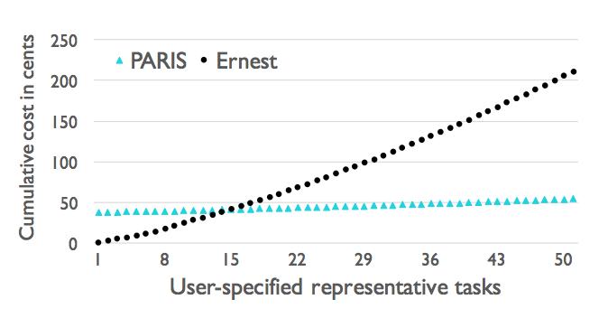
PARIS - Summary
Advantages:
One-time data collection
Short training time
Comprehensive
Useful output
More cost effective than previous solutions
Disadvantages:
Requires a representative task
Cannot handle task specific features
Cannot tackle scale or distributed tasks

Slide 38
Current State-of-the-Art
Vmchooser
Ref: https://kvaes.wordpress.com/2017/07/01/what-azure-virtual-machine-size-should-i-pick/

Slide 39
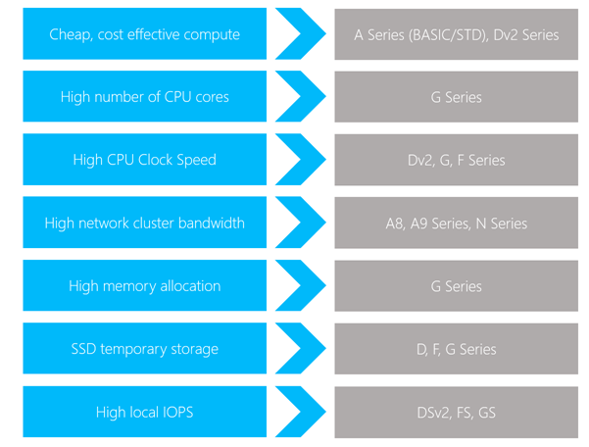
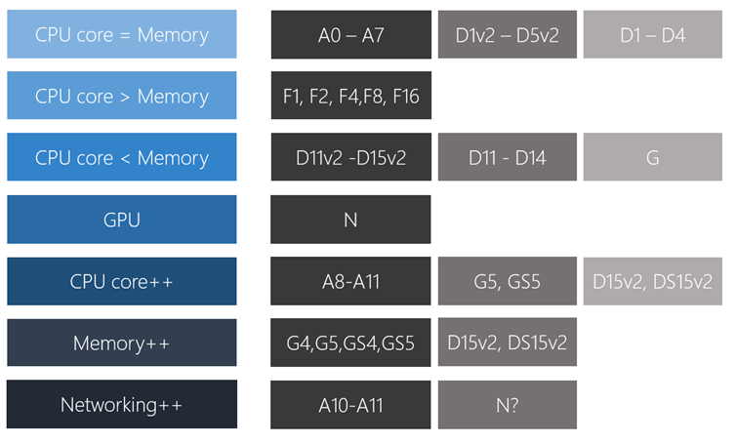
Current State-of-the-Art
Microsoft’s guidelines
Ref: https://blogs.msdn.microsoft.com/uk_faculty_connection/2016/09/12/choosing-the-most-appropiate-azure-virtual-machine-specification/

Slide 40
Current State-of-the-Art
Amazon’s guidelines
General purpose
Compute optimized
Memory optimized
Storage optimized
Micro instances
GPU instances
Ref: https://aws.amazon.com/blogs/aws/choosing-the-right-ec2-instance-type-for-your-application/
Notes:
General purpose - backend servers
Compute optimized – video encoding
Memory optimized – high-perf databases
Storage optimized – data warehouses
Micro instances - administrative tasks
GPU instances – computational chemistry

Slide 41
Conclusion
Choosing the right VM type for an application is critical
Important to consider cost vs performance trade off
Three main approaches discussed :
Ernest
CherryPick
PARIS
Highlights the use of Machine Learning model in selecting the right VM type

